Slide 1
Automated Fake News Detection
BIA-660-C
Final Project
Team 3:
Viveksinh Solanki
Akshay Rane
Ronald Fernandes
Gaurang Patel

Slide 2
Introduction
In simpler terms,
“Fake news can be defined as any news with false information and which is created with the intent of misleading people”
Traditional approaches of fighting fake news:
human annotators who manually check all the news and decide its genuineness based on the available truthful resources
time consuming and tedious
By borrowing methods from ML and NLP, fake news detection can be automated at some degree
Faster and cheaper
Trad-off for accuracy

Slide 3
Motivation
In the past couple of years, India has faced many mob lynching incidents due to the spread of fake news on one of the top social media platforms, WhatsApp.
Affected 2016 US presidential elections
Ongoing elections in India are also being influenced, via fake news being spread on social media platforms.

Slide 4
Data collection: fake articles
Source: https://en.wikipedia.org/wiki/Wikipedia:Zimdars%27_fake_news_list
Scraped 1000 fake articles from : https://100percentfedup.com
Category: Politics
About website:
Questionable, based on extreme right-wing bias through story selection,
use of poor sources, promotion of propaganda using loaded emotional wording,
failed fact checks by fact checkers, and a complete lack of transparency

Slide 5
Data collection: real articles
Source: https://en.wikipedia.org/wiki/News_media_in_the_United_States
Scraped 1000 real articles from : https://api.nytimes.com/
Category: Politics
About website:
Founded in 1851, this paper has won 127 Pulitzer Prizes, more than any other newspaper
The Times is ranked 17th in the world by circulation and 2nd in the U.S

Slide 6
Feature Engineering (before EDA)
Punctuation count:
We believe that fake news has exaggerated tone and eventually more punctuations
On further analysis, the punctuation count for body of real news was greater, since content length of real news was greater than fake news
Word count :
Initially thought to use as a feature
Word distribution is skewed for ‘real’ labels

Slide 7
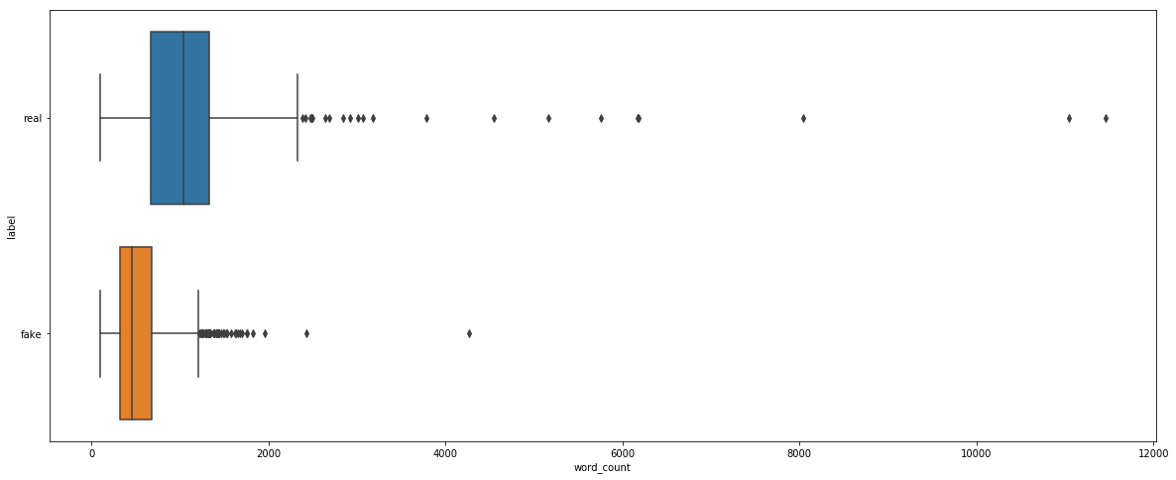
We kept 75th percentile of fake labels which is approx. 700 as upper bound of word count for any document in our dataset.
So, removed documents with word count > 700
Remaining documents:
Fake: 757
Real: 228 (as it was skewed with more words)

Slide 8
Data Cleaning (before EDA)
Converted documents to lowercase
Removed punctuations using the following regular expression : [^A-Za-z0-9^+-=]
Removed newline characters
Removed ‘english’ stop words

Slide 9
Preprocessing (before EDA)
Converted labels
Fake - 1
Real - 0
Dropped duplicates
Dropped missing (NaN) values

Slide 10
EDA-1
Word cloud
Encountered words specifying author name, advertisement, twitter URLs etc. with high frequencies
Found some repeated texts (see Table 1)
Plotted word frequency distribution for each label and each dataset
Found some unrelated words (want, would, anything etc..)
Random forest feature importance
Plotted top 30 important features
Encountered some repeated n-grams(bigrams, trigrams, four-grams) with no inference
Encountered more unrelated words with high frequency(missing, think etc..)
Found more repeated texts (see Table 1)

Slide 11
Table 1
Repeated Strings | Frequency
“welcome guide national host” | 84
“busy american biggest stories might missed links read” | 23
“stories making news washington today” | 127
“love hear email” | 241
“forwarded subscribe delivered” | 157
“today briefing compiled” | 141
“isabella grull” | 101
“read story” | 51
“trending katie hopkins warns americans grave danger ahead great country become united kingdom” | 977

Slide 12
Preprocessing (Post EDA-1)
Transformed values
Replaced the word “dem” with “democrats”
Replaced the word “rep” with “republicans”
Removed words with length < 3
Updated stop words list
Appended repeated words encountered in EDA-1 to original “stop word” list.
Removed repeated strings mentioned in Table 1
Sampling and balancing labels for final dataset
Statements dataset: fake-747 and real-747
Content dataset: fake-228 and real-228

Slide 13
Contd..
To reduce document length bias in final content dataset
We counted number of words occurring in more than 15% (word freq=30) documents
Count = 585
Hence, used max_features=500 for Tf-Idf vectorizer
This will help in disregarding rare/biased words for both labels

Slide 14
EDA-2
Fake News Statements
Real News Statements

Slide 15
EDA-2
Fake News Content
Real News Content

Slide 16
EDA-2
Top 30 words in fake news statements

Slide 17
EDA-2
Top 30 words in real news statements

Slide 18
EDA-2
Top 30 words in fake news content

Slide 19
EDA-2
Top 30 words in real news content

Slide 20
EDA-2
Top 30 features using Random Forest feature importance – Content dataset

Slide 21
Experiments and results: SVM
Statement dataset: (Used GridSearch)
TF-IDF params: analyzer =‘ char_wb’, min_df=7, ngram_range=(1,6)
Best f1_macro on test set: 84.71%
Content dataset: (Used 5-fold cross-validation)
TF-IDF params: max_features = 500
Average f1_macro on test set: 88.12%

Slide 22
Experiments and results: MNB
Statement dataset: (Used GridSearch)
TF-IDF params: analyzer =‘ char_wb’, min_df=1, ngram_range=(1,4)
MNB params: alpha=0.5
Best f1_macro on test set: 79.12%
Content dataset: (Used 5-fold cross-validation)
TF-IDF params: max_features = 500
Average f1_macro on test set: 86.06%

Slide 23
Experiments and results: Random Forest
Statement dataset: (Used GridSearch)
TF-IDF params: analyzer =‘ char_wb’, min_df=5, ngram_range=(1,5)
Best f1_macro on test set: 85.56%
Content dataset: (Used 5-fold cross-validation)
TF-IDF params: max_features = 500
Average f1_macro on test set: 84.85%

Slide 24
Experiments and results: CNN
Statement dataset:
Got very low f1_macro (around 50%)
Due to smaller size of document as well as dataset
Hence, CNN didn’t work for this dataset
Content dataset:
Word Embeddings using 100D pretrained GloVe vectors
VOCAB_SIZE = 500 (kept same as max-features)
MAX_SEQUENCE_LENGTH = 698
EMBEDDING_DIMS = 100
FILTERS = 128 #number of filters
KERNEL_SIZE = 7 #filter window size
BATCH_SIZE = 50
Early Stopping with patience=7

Slide 25
Contd..
Accuracy: 75.18%
Classification report
precision recall f1-score support
0 0.91 0.57 0.70 69
1 0.68 0.94 0.79 68
micro avg 0.75 0.75 0.75 137
macro avg 0.79 0.75 0.74 137
weighted avg 0.79 0.75 0.74 137
f1-Score: 79.01%

Slide 26
Findings
Fake News Detection solely based on ML methods is not robust at all!
Model performance will totally depend on the dataset
Proposed approach : Inclusion of automated evidence checking

Slide 27
What can be improved?
Extract tone/emotion from the given text and utilize it as new feature
Use more balanced and less biased dataset
Try different fake/real news sources and combined them in single dataset
Multiple topics can be included
Add sentiments as new feature

Slide 28
Questions/Suggestions/Feedback

